Slide 1

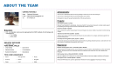
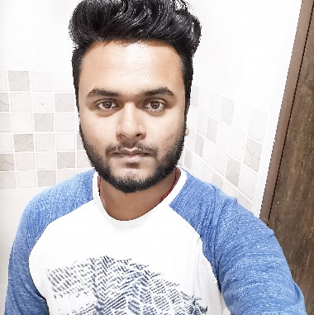
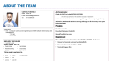
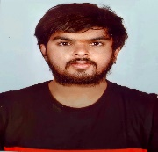
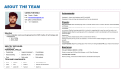
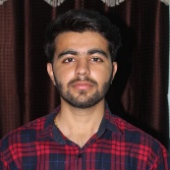
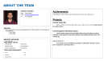
ABOUT THE TEAM
TEAM NAME: Team 17
PROJECT DESCRIPTION: COVIDON : A COVID PREVENTION AND AWARENESS WEBSITE
TEAM DETAILS: COLLEGE : BMS INSTITUTE OF TECHNOLOGY, NUMBER OF MEMBERS : 4
TEAM MEMBERS |  | SKILLS | CONTRIBUTION | DETAILS
Subbhashit Mukherjee (Team Leader) |  | python , javascript , data science,machine learning ,vuejs, mysql ,node js ,mongo | Developed machine learning models and backend support in python for data analysis.
Shree Ratn |  | Python, java, machine learning, data analytics, deep learning, Android, Tableau | Developed live mask detection system in the project
Tarush J Reddy |  | Python, Javascript , java, Dart, Machine learning, AI, Android, Node-js , Mysql , Mongo, Angular, React, Vue-js , Typescript, Deep Learning, UI/ UX, | Developed the UI, some part of the Machine Learning and the graphic part.
Vikram Borana P. |  | Java , Python ,Javascript ,Data Analysis | Performed web scraping and developed the UI of our website

Slide 2
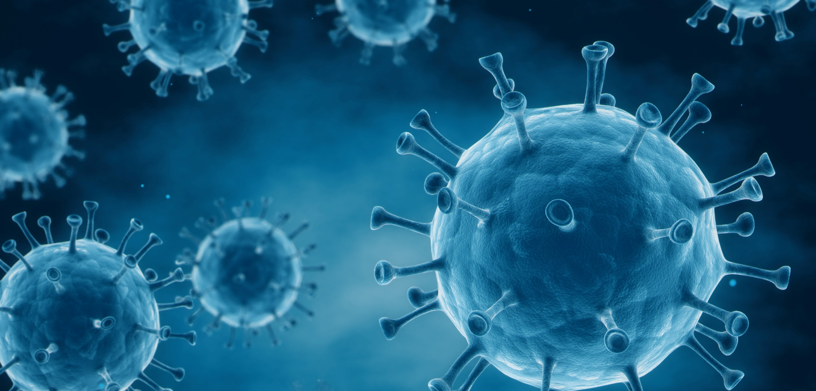
WHAT DO WE HAVE FOR YOU TODAY
01
02
What we are trying to do here
Use case overview and value proposition
How would it work
A quick look at solution architecture, data requirements and approach
03
04
What we have created for this mvp
Data sources, analytical modules and output
What next
Exploring the possible areas of enhancement
05
annexure
Details on solution and code snippetS

Slide 3
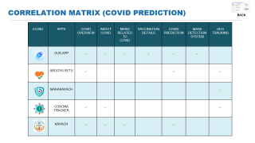
WHAT WE ARE TRYING TO DO HERE
01
WHAT WE HAVE CREATED
HOW WOULD IT HELP
What we are trying to do here
With our web application , we trying to spread awareness and provide preventive measures related to corona
Multiple features in a single app – AI powered use cases (latest news, prediction system, mask detection system)
Highly accurate results
Inexpensive solution
Use case overview; value proposition
02
COVID OVERVIEW
How would it work
Provides details related to vaccination and daily covid cases
03
Provides news related to covid from all over the world
What we have created for this mvp
MASK DETECTION SYSTEM
How is this different from existing products in the market
04
Helps detecting if a person is wearing mask properly or not.
What next
COVID PREDICTION SYSTEM
Helps predicting if a person is Covid positive or not

Slide 4
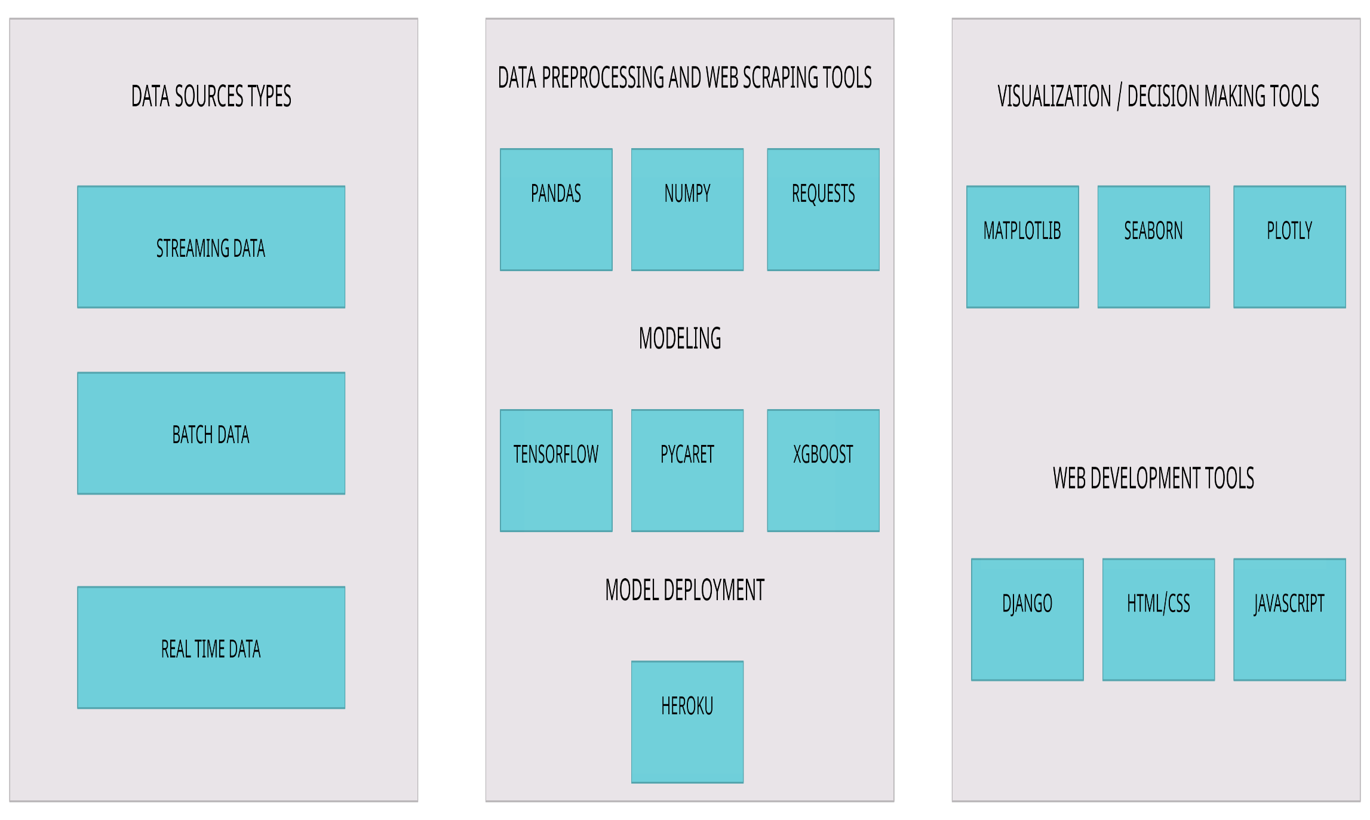










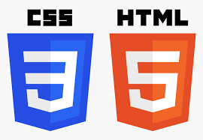


HOW WOULD IT WORK
01
What we are trying to do here
02
How would it work
Solution architecture
Data requirements
Our approach
03
What we have created for this mvp
04
What next

Slide 5
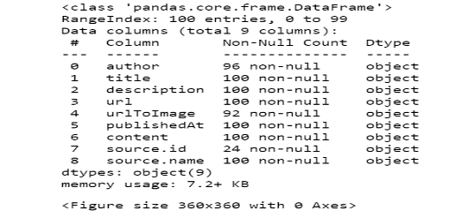
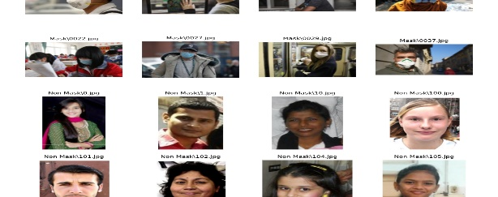
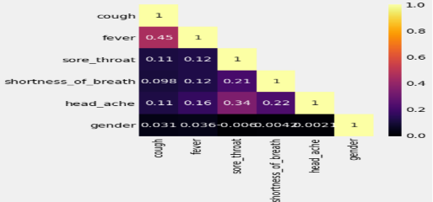


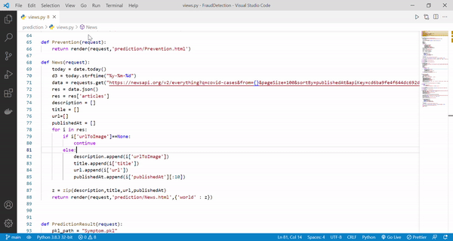
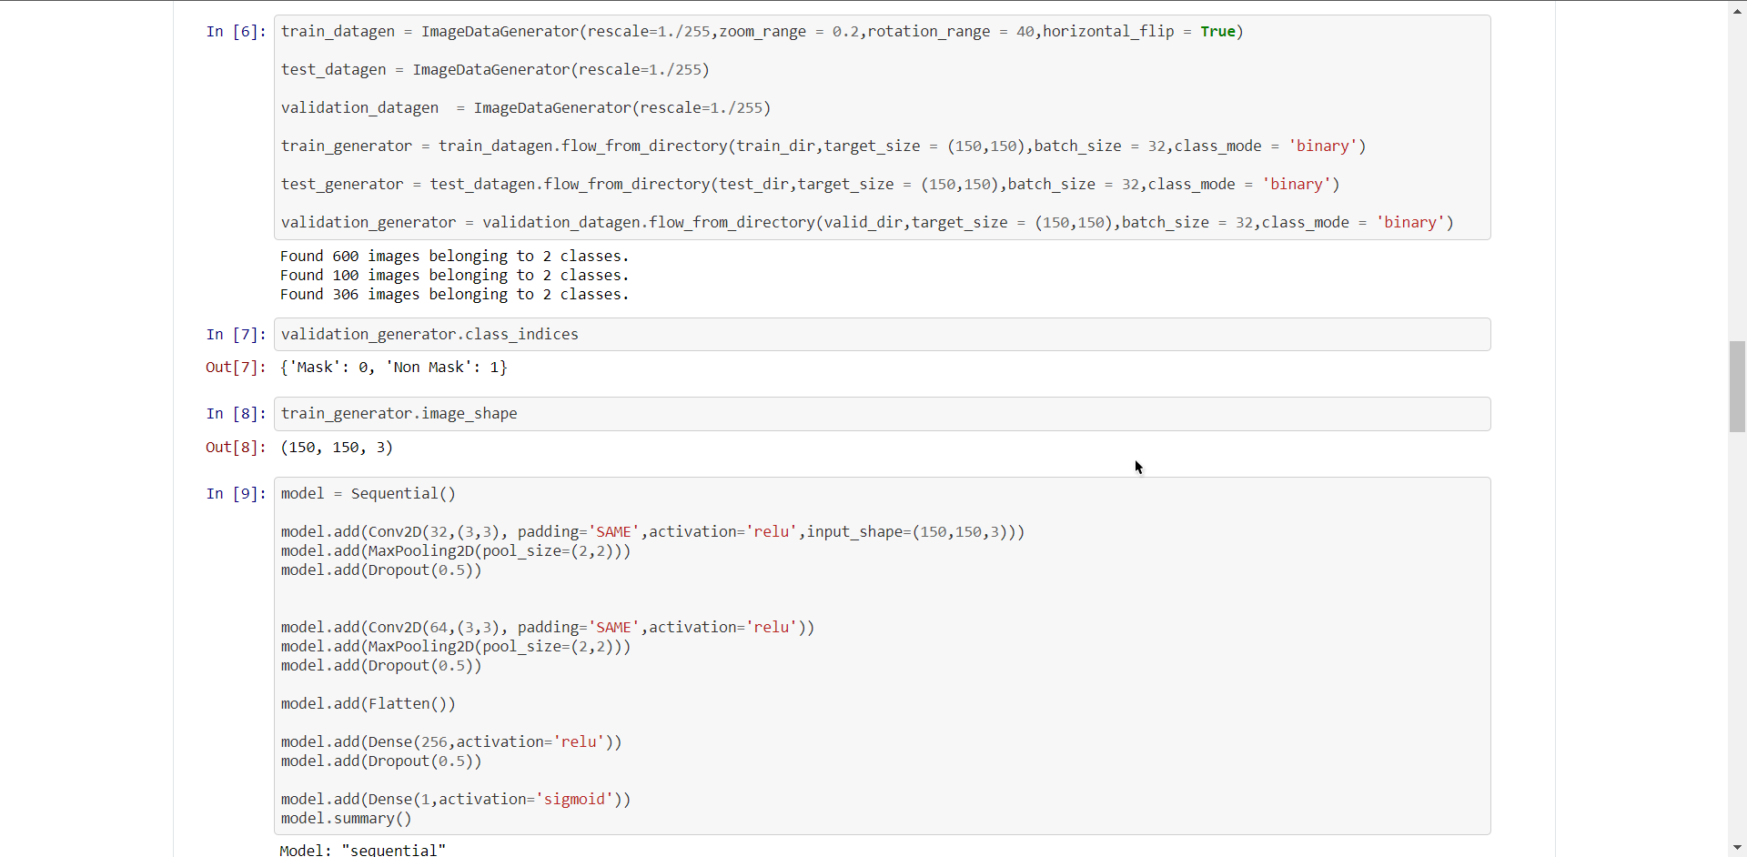
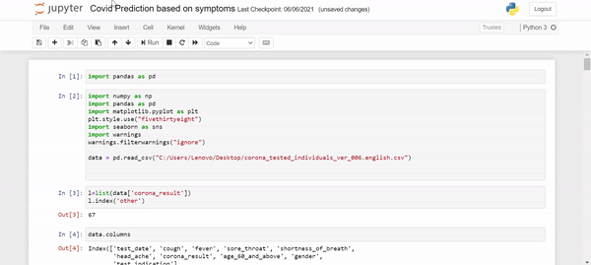
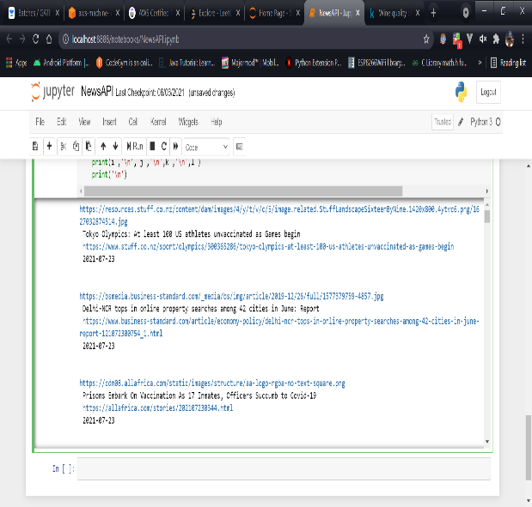
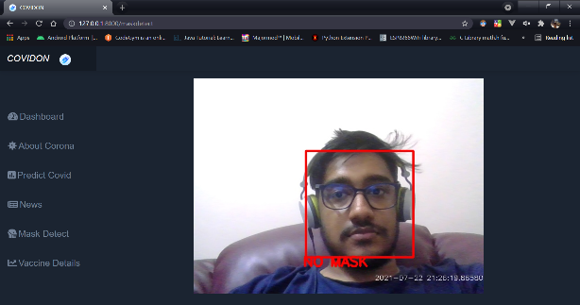
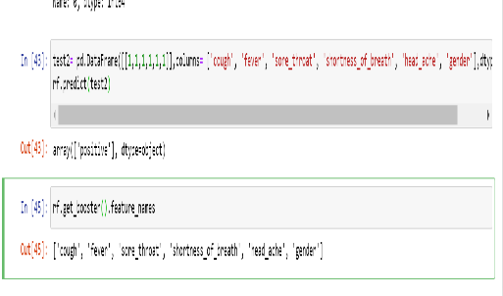
WHAT WE HAVE CREATED FOR THIS MVP
NEWS PORTAL
MASK DETECTION SYSTEM
COVID PREDICTION SYSTEM
01
DATA TYPES
What we are trying to do here
02
How would it work
DATA SOURCES
03
Covid Cases API (JSON)
Covid Cases Country wise API (JSON)
News API
(JSON)
Covid Prediction Dataset (CSV)
Vaccination Details
(CSV)
Vaccinated Count Dataset (CSV)
Mask Dataset
(.JPG)
What we have created for this mvp
ANALYTICAL MODULES
Data sources,
Analytical modules,
Output,
APPLICATION WIREFRAMES
04
What next
OUTPUT

Slide 6
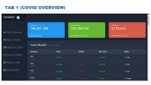
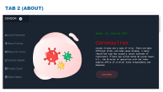
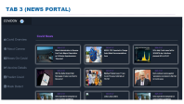
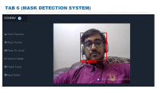
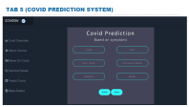
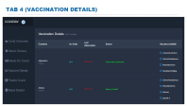
APPLICATION WIREFRAMES
01
What we are trying to do here
1
2
3
02
How would it work
1 – Covid cases Information from all over the world with interactive visuals
2 – About Corona - its symptoms and methods to prevent it.
3 – News related to Covid from all over the world
03
What we have created for this mvp
Data sources,
Analytical modules,
Output,
APPLICATION WIREFRAMES
6
5
4
04
What next
6 – Mask detection system to check if a person is masked or not.
5 – Covid Prediction System to check if a person might be covid positive or not.
4 - Vaccine information related to Covid with all the vaccines available for each country with interactive visuals.
COVIDON

Slide 7
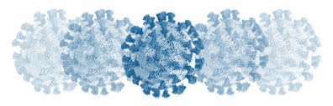
WHAT NEXT
01
What we are trying to do here
02
How would it work
03
What we have created for this mvp
technical
ENHANCEMENTS
Analytical
enhancements
FUNCTIONAL
enhancements
COLLABORATION WITH key USERS
/ integration proposal
04
Display Enhancement: Our app displays perfectly on desktop computers but not on mobiles. Would like to enhance it in future.
Will use cloud services for developing and deploying deep learning models for better performance and data security
We can consider more attributes/ factors influencing infection for training our covid prediction system. For example , Age, population density etc.
We can use transfer learning models for our mask detection system like VGG19 and RESNET50.
While providing the new update – additional capability in terms of country- based filter.
We can add popularity-based news recommender for better quality content.
Capability to forecast covid cases for the upcoming days/ waves by country/ region/ area
Our web app will help common people to see news , vaccination and covid daily cases details in a single app.
Our Covid Prediction System can be used by any government hospitals to help patients to check if a person should do a covid test or not
Our face mask detector can be very effectively used at airports and other public places mainly for entrance flow management and monitoring.
What next
Exploring the possible areas of enhancement

Slide 8
THANK YOU

Slide 9
WORKING PROTOTYPE AND GitHub REPO
Github Web App Code : https://github.com/23subbhashit/COVIDON
Github Covid Prediction Code : https://github.com/23subbhashit/CovidSymtopmPrediction
Github Mask Detection Code : https://github.com/shreeratn/Mask-detection-COVID
Video Link : https://youtu.be/THcX6KlJsl8

Slide 10
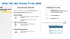





EXISTING APPS VS OUR PRODUCT
BACK
ICONS | APPS | COVID OVERVIEW | ABOUT COVID | NEWS RELATED TO COVID | VACCINATION DETAILS | COVID PREDICTION | MASK DETECTION SYSTEM | GEO TRACKING
 | OUR APP |   ✓ | ✓ | ✓ | ✓ | ✓ | ✓
 | AROGYA SETU | ✓ |  |  |  | ✓ |  | ✓
 | MAHAKAVACH |  |  |  |  |  |  | ✓
 | CORONA TRACKER | ✓ | ✓ |  |  |  |  | ✓
 | KAVACH | ✓ | ✓ | ✓ |  | ✓

Slide 11

CORRELATION MATRIX (COVID PREDICTION)

Slide 12

DATA INFORMATION (NEWS API)

Slide 13
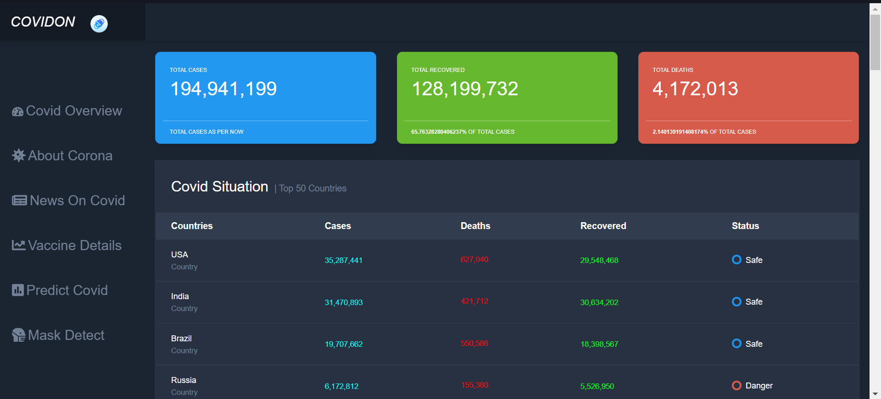
TAB 1 (COVID OVERVIEW)

Slide 14
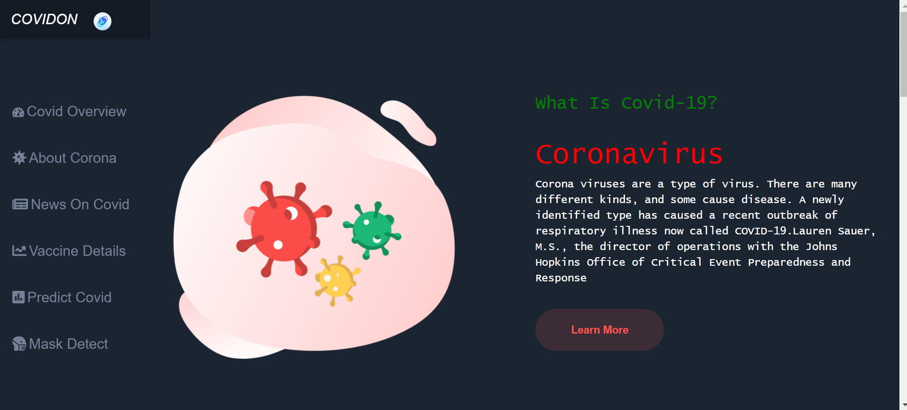
TAB 2 (ABOUT)

Slide 15
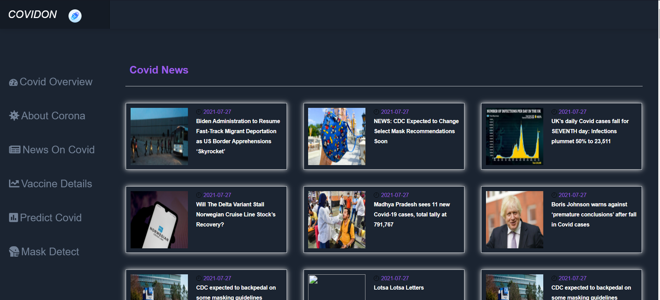
TAB 3 (NEWS PORTAL)

Slide 16
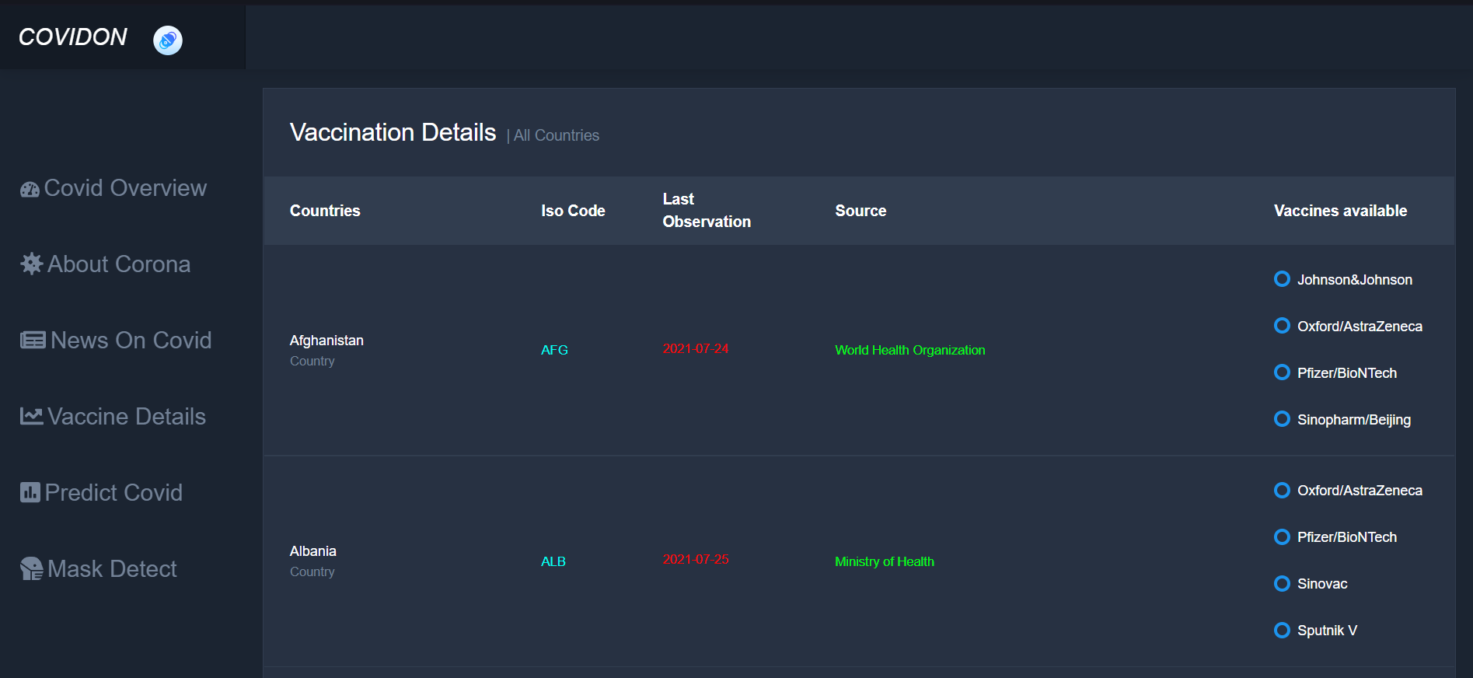
TAB 4 (VACCINATION DETAILS)

Slide 17
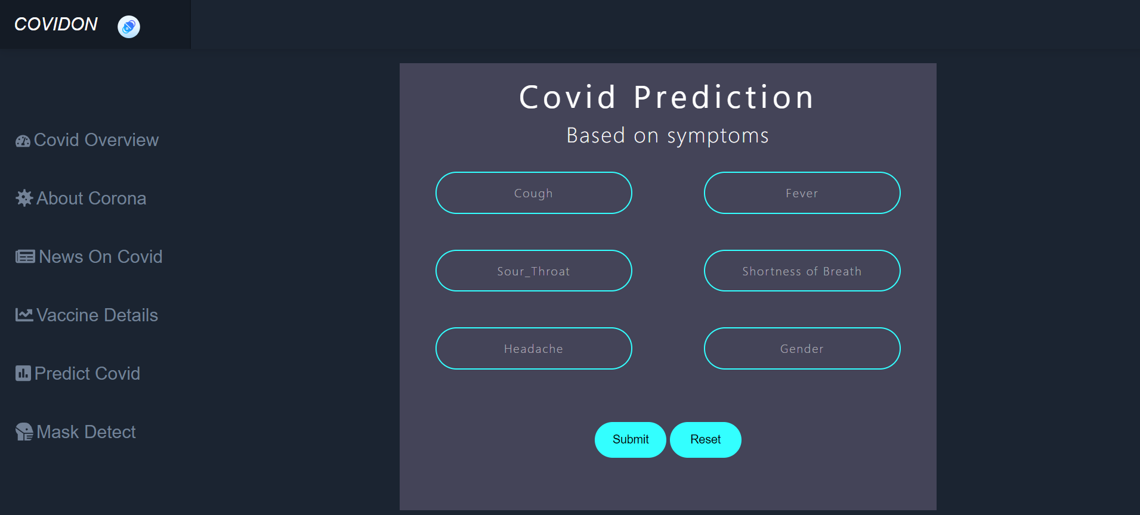
TAB 5 (COVID PREDICTION SYSTEM)

Slide 18
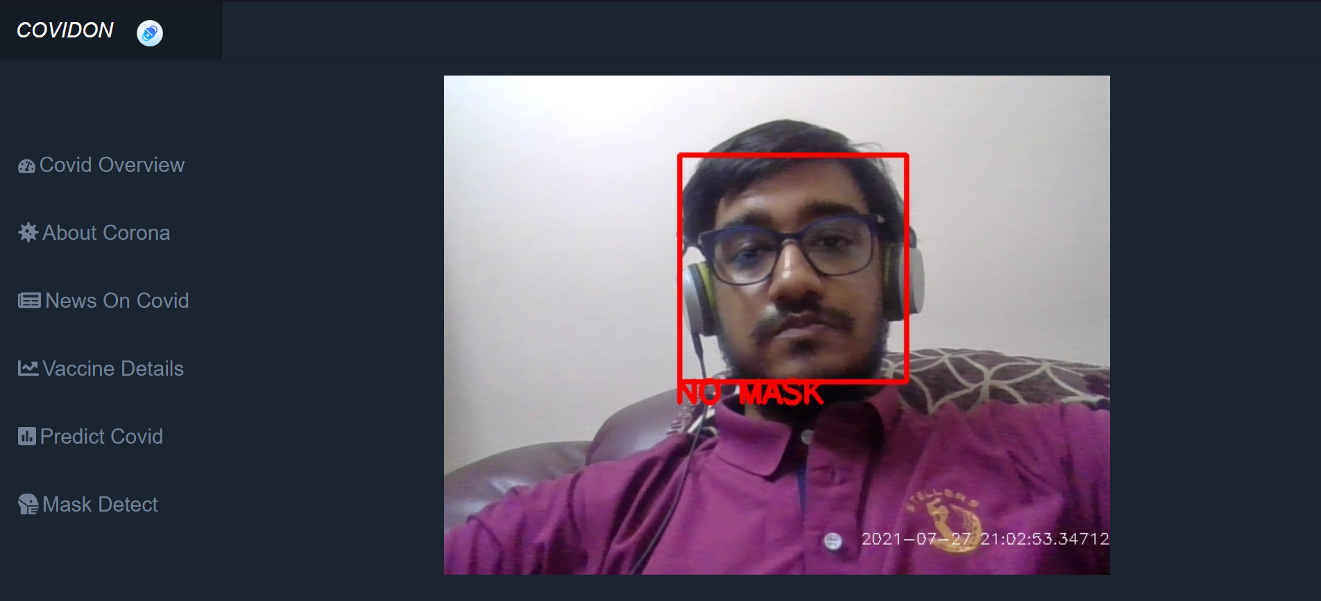
TAB 6 (MASK DETECTION SYSTEM)

Slide 19
COVID PREDICTION CODE

Slide 20
NEWS API FETCHING

Slide 21
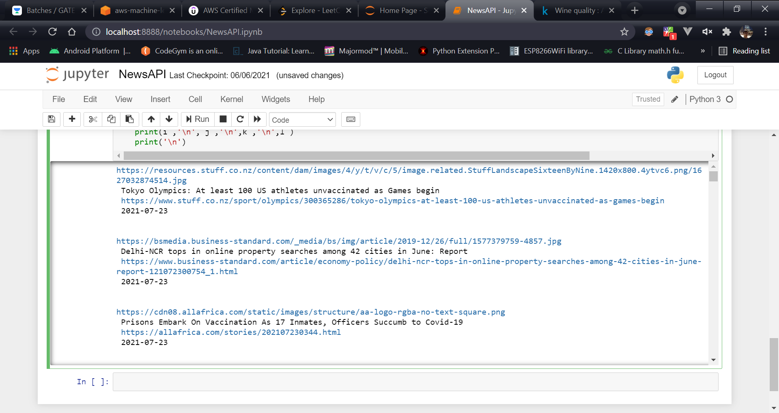
NEWS API FETCHING (OUTPUT)

Slide 22
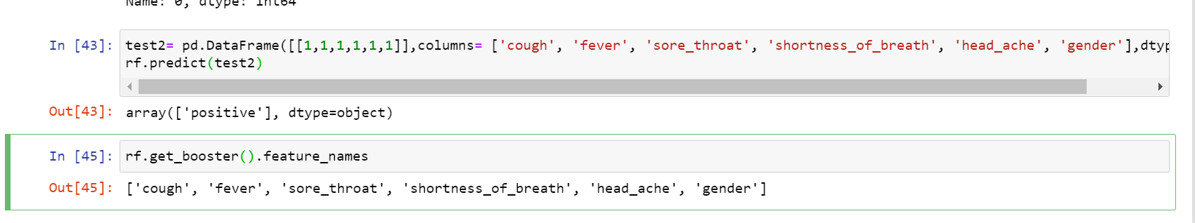
COVID PREDICTION CODE (OUTPUT)

Slide 23
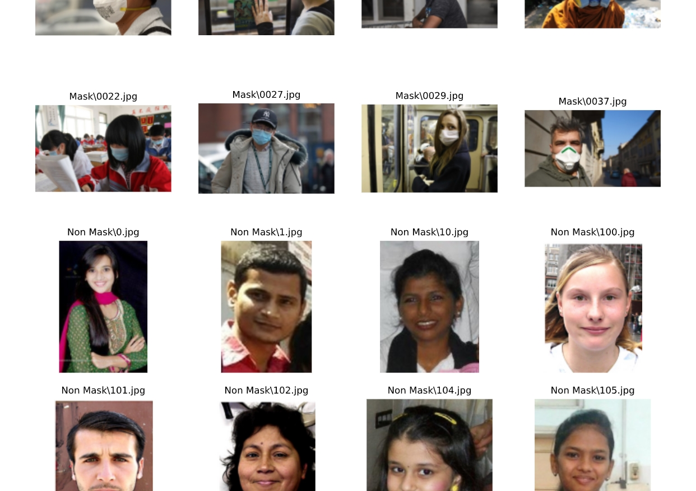
COVID MASK PICTURE (INPUT)

Slide 24
COVID MASK GRAPH (TRAINING)

